Slide 1
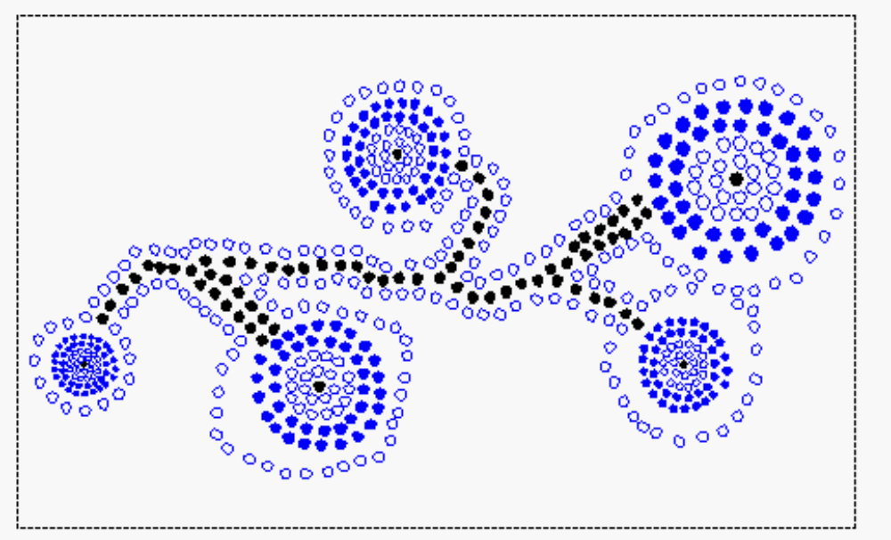
Priority Queues
Scheduling example
The priority queue ADT
Implementing a priority queue with a sequence
Binary Heaps
Insertion in a Heaps and Heapify

Slide 2
Scheduling
In a multi-user computer system, multiple users submit jobs to run on a single processor.
We assume that the time required by each job is known in advance. Further, jobs can be preempted (stopped and resumed later)
One policy which minimizes the average waiting time is SRPT (shortest remaining processing time).
The processor schedules the job with the smallest remaining processing time.
If while a job is running a new job arrives with processing time less than the remaining time of current job, the current job is preempted.

Slide 3
Data Structure for SRPT
We need to maintain the remaining processing time of the unfinished jobs at any point in time.
We need to find the job with the shortest remaining processing time.
When a job finishes we should remove it from our collection.
When a new job arrives we need to add it to the collection.

Slide 4
Priority Queues
A priority queue is an ADT(abstract data type) for maintaining a set S of elements, each with an associated value called priority
A PQ supports the following operations
  Insert(x) insert element x in set S (S←S∪{x})
  Minimum() returns the element of S with smallest priority.
  Delete-min() returns and removes the element of S with smallest priority.

Slide 5
Priorities and Total Order Relations
A Priority Queue ranks its elements by priority.
Every element has a priority. Priorities are not necessarily unique and are totally ordered.
Total Order Relation, denoted by ≤
  Reflexive: k ≤ k
  Antisymetric: if k1 ≤ k2 and k2 ≤ k1, then k1 ≤ k2
  Transitive: if k1 ≤ k2 and k2 ≤ k3, then k1 ≤ k3

Slide 6
Comparators
The most general and reusable form of a priority queue makes use of comparator objects.
Comparator objects are external to the keys that are to be compared and compare two objects.
When the priority queue needs to compare two keys, it uses the comparator it was given to do the comparison.
Thus a priority queue can be general enough to store any object.
The comparator ADT includes:
  isLessThan(a, b), isLessThanOrEqualTo(a,b),
  isEqualTo(a, b), isGreaterThan(a,b),
  isGreaterThanOrEqualTo(a,b), isComparable(a)

Slide 7
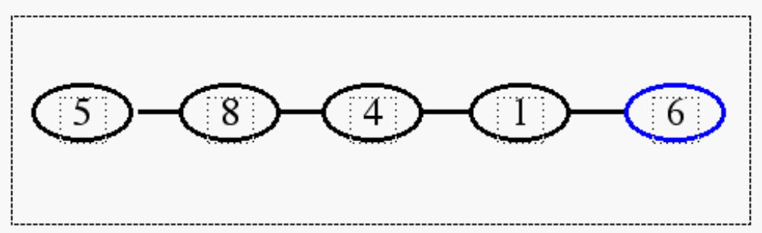
Implem. with Unsorted Sequence
The items are pairs (priority, element)
We can implement insert() by using insertLast() on the sequence. This takes O(1) time.
However, because we always insert at the end, irrespective of the key value, our sequence is not ordered.

Slide 8
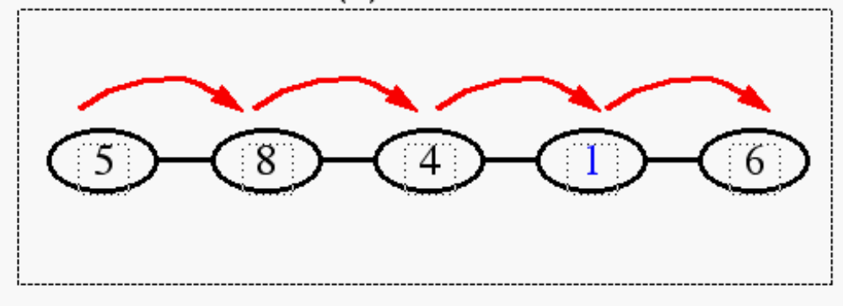
Unsorted Sequence (contd.)
Thus, for methods such as minimum(),delete-min() we need to look at all the elements of S. The worst case time complexity for these methods is O(n).

Slide 9
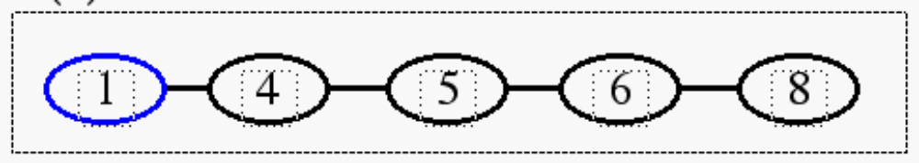
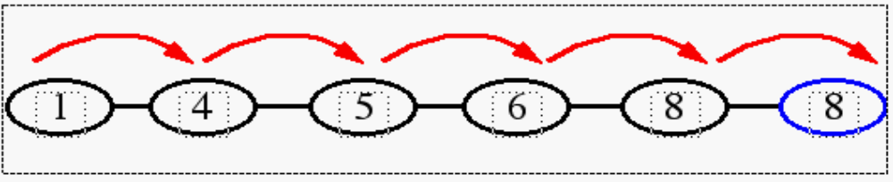
Implem. with Sorted Sequence
Another implementation uses a sequence S, sorted by increasing priorities.
minimum() and delete-min() take O(1) time.
However, to implement insert(), we must now scan through the entire sequence in the worst case. Thus insert() runs in O(n) time.

Slide 10
Priority Queues
Applications:
  job scheduling shared computing resources (Unix)
  Event simulation
  As a building block for other algorithms
A Heap can be used to implement a PQ

Slide 11
(Binary) Heaps
A binary tree that stores priorities (or priority-element) pairs at nodes
Structural property: All levels except last are full. Last level is left-filled.
Heap property: Priority of node is at least as large as that of its parent.
11
17
13
18
21
19
17
43
23
26
29
31

Slide 12
Examples of non-Heaps
Heap property violated
11
19
13
18
21
19
17
43
23
26
29
31

Slide 13
Example of non-heap
Last level not left-filled
11
17
13
18
21
19
17
43
26
29
31

Slide 14
Finding the minimum element
The element with smallest priority always sits at the root of the heap.
This is because if it was elsewhere, it would have a parent with larger priority and this would violate the heap property.
Hence minimum() can be done in O(1) time.

Slide 15
Height of a heap
Suppose a heap of n nodes has height h.
Recall: complete binary tree of height h has 2^{h+1}-1 nodes.
Hence 2^{h}-1 < n <= 2^{h+1}-1.
n = ⎣log₂ h⎦

Slide 16
Implementing Heaps
Parent (i)
return ⎣i/2⎦
Left (i)
return 2i
Right (i)
return 2i+1
11
17
13
18
21
19
17
43
23
26
1 | 2 | 3 | 4 | 5 | 6 | 7 | 8 | 9 | 10
11 | 17 | 13 | 18 | 21 | 19 | 17 | 43 | 23 | 26
A
Level: 0 1 2 3
Heap property: A[Parent(i)] <= A[i]

Slide 17
Implementing Heaps (2)
Notice the implicit tree links; children of node i are 2i and 2i+1
Why is this useful?
  In a binary representation, a multiplication/division by two is left/right shift
  Adding 1 can be done by adding the lowest bit

Slide 18
Insertion in a Heap
Insert 12
Insert 8
11
17
13
18
21
19
17
43
23
26
29
31
12
8

Slide 19
Another View of Insertion
Enlarge heap
Consider path from root to inserted node
Find topmost element on this path with higher priority that that of inserted element.
Insert new element at this location by shifting down the other elements on the path
11
12
17
13
18
21
19
17
43
23
26
29
31

Slide 20
Correctness of Insertion
The only nodes whose contents change are the ones on the path.
Heap property may be violated only for children of these nodes.
But new contents of these nodes only have lower priority.
So heap property not violated.
11
17
13
12
18
21
19
17
43
23
26
29
31

Slide 21
Heapify
i is index into the array A
Binary trees rooted at Left(i) and Right(i) are heaps
But, A[i] might be smaller than its children, thus violating the heap property
The method Heapify makes binary tree rooted at i a heap by moving A[i] down the heap.

Slide 22
Heapify
Heap property violated at node with index 1 but subtrees rooted at 2, 3 are heaps.
heapify(1)
17
10
11
16
21
13
12
43
23
26
29
31
19

Slide 23
Another View of Heapify
Heapify(i) traces a path down the tree.
Last node on path (say j) has both A[left(j)], A[right(j)] are larger than A[i]
All elements on path have lower priority than their siblings.
All elements on this path are moved up.
A[i] goes to location j.
This establishes correctness
17
10
11
16
21
13
12
43
23
26
29
31
19

Slide 24
Running time Analysis
A heap of n nodes has height O(log n).
While inserting we might have to move the element all the way to the top.
Hence at most O(log n) steps required.
In Heapify, the element might be moved all the way to the last level.
Hence Heapify also requires O(log n) time.

